Slide 1
Process management

Slide 2
A UNIX process is an instance of a running program
Every process in UNIX system has the following attributes:
Text segment
Data segment
Stack
A unique process ID (PID) number

Slide 3
Process Creation
When UNIX is first started, there’s only one visible process in the system
This process is called “init”, and is PID 1
The only way to create a new process in UNIX is to duplicate an existing process.
“init” is the ancestor of all subsequent processes
When a process duplicates, the parent and child processes are virtually identical
A child process may, however, replace its code with that of another executable file, there by differentiating itself from its parent.

Slide 4
Process hierarchy
In UNIX, there is a concept known as process hierarchy.
In this concept there is a parent process which can create child processes.
The child processes can in turn create their own child processes thus forming a hierarchy of processes.
This is also known as a process group

Slide 5
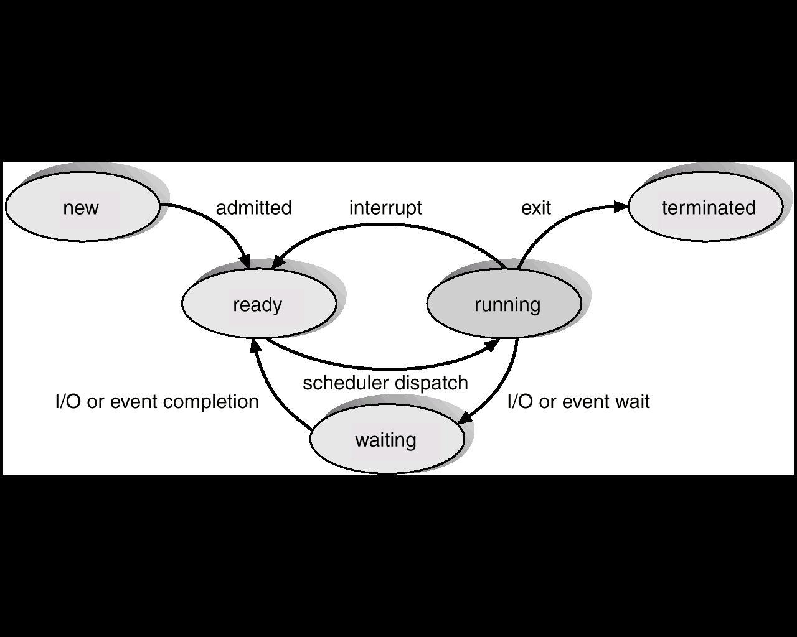
As a process executes, it changes state
new: The process is being created.
running: Instructions are being executed.
waiting: The process is waiting for some event to occur.
ready: The process is waiting to be assigned to a process.
terminated: The process has finished execution.

Slide 6
Creating a New Process: fork ()
The child process is an almost exact duplicate of the original parent process
the parent and child have different process ID numbers
If fork () succeeds, it returns the PID of the child to the parent process and returns 0 to the child process.
If fork () fails, it returns -1 to the parent process and no child is created.

Slide 7
#include <stdio.h>
main ()
{
int pid;
printf (“I’m the original process with PID %d and PPID %d.\n”),
getpid (), getppid ());
pid = fork (); /* Duplicate. Child and parent continue from here */
if (pid != 0) /* pid is non-zero, so I must be the parent */
{
printf (“I’m the parent process with PID %d and PPID %d.\n”,
getpid (), getppid ());
printf (“My child’s PID is %d\n”, pid);
}
else
{
printf (“I’m the child process with PID %d and PPID %d.”,
getpid (), getppid ());
}
printf(“PID %d terminates.\n”, getpid () ); /* Both processes execute this */
}

Slide 8
output
I’m the original process with PID 13292 and PPID 13273.
I’am the parent process with PID 13292 and PID 13273.
My child’s PID is 13293.
I’m the child process with PID 13293 and PPID 13292.
PID 13293 terminates.
PID 13292 terminates.

Slide 9
Orphan Processes
If a parent dies before its child, the child is automatically adopted by the original “init” process, PID 1.
To demonstrate the feature, the previous program is modified by inserting a sleep statement into the child’s code.
This ensured that the parent process terminated before the child .

Slide 10
#include <stdio.h>
main ()
{
int pid;
printf (“I’m the original process with PID %d and PPID %d.\n”),
getpid (), getppid ());
pid = fork (); /* Duplicate. Child and parent continue from here */
if (pid != 0) /* pid is non-zero, so I must be the parent */
{
printf (“I’m the parent process with PID %d and PPID %d.\n”,
getpid (), getppid ());
printf (“My child’s PID is %d\n”, pid);
}
else
{
/* pid is zero, so I must be the child */
sleep (5); /* Make sure that the parent terminates first */
printf (“I’m the child process with PID %d and PPID %d.”,
getpid (), getppid ());
}
printf(“PID %d terminates.\n”, getpid () ); /* Both processes execute this */
}

Slide 11
output
I’m the original process with PID 13364 and PPID 13346.
I’am the parent process with PID 13364 and PID 13346.
PID 13364 terminates.
I’m the child process with PID 13365 and PPID 1.
PID 13365 terminates.

Slide 12
Terminating a process: exit ()
A process may terminate at any time by executing exit ()
The termination code of a child process may be used for a variety of purposes by a parent process.

Slide 13
system call : void exit(int status)
exit () closes all of a process’ file descriptors, deallocates its code, data and stack and then terminates the process.
When a child process terminates, it sends its parent a SIGCHLD signal and waits for its termination code status to be accepted.
A process that is waiting for its parent to accept its return code is called a zombie process.
A parent accepts a child’s termination code by executing wait ().

Slide 14
#include <stdio.h>
main ()
{
printf (“I’m going to exit with return code 42\n”);
exit (42);
}

Slide 15
Zombie Processes
A process that terminates cannot leave the system until its parent accepts its return code.
If its parent process is already dead, it’ll already have been adopted by the “init” process, which always accepts its children’s return codes.
However, if a process’ parent is alive, but never executes a wait (), the child process’ return code will never be accepted and the process will remain a zombie

Slide 16
Waiting for a Child: wait ()
A parent process may wait for one of its children to terminate and then accept its child’s termination code by executing wait ().
System Call: pid_t wait (int *status)
wait () causes a process to suspend until one of its children terminates.
A successful call to wait () returns the PID of the child that terminated

Slide 17
main ()
{
int pid, status, childPid;
printf (“I’m the parent process and my PID is %d\n”, getpid() );
pid = fork () ; /* Duplicate */
if (pid != 0) /* Branch based on return value from fork () */
{
printf (“I’m the parent process with PID %d and PPID %d\n”,
getpid (), getppid () );
childPid = wait (&status); /* Wait for a child to terminate */
printf (“A child with PID %d terminated with exit code %d\n”,
childPid, status >>8);
}
else
{
printf (“I’m the child process with PID %d and PPID %d\n”,
getpid (), getppid () );
exit (42); /* Exit with a silly number */
}
printf (“PID %d terminates\n”, getpid () );
}

Slide 18
I'm the parent process and my PID is 28208
I'm the parent process with PID 28208 and PPID 28133
I'm the child process with PID 28209 and PPID 28208
A child with PID 28209 terminated with exit code 42
PID 28208 terminates

Slide 19
waitpid()
Either of wait or waitpid can be used to remove zombies
wait (and waitpid in it's blocking form) temporarily suspends the execution of a parent process while a child process is running.
Once the child has finished, the waiting parent is restarted.

Slide 20
#include <sys/types.h>
#include <sys/wait.h>
pid_t wait(int *statloc);
/* returns process ID if OK, or -1 on error */
pid_t waitpid(pid_t pid, int *statloc, int options);
/* returns process ID : if OK, *
-1 : on error

Slide 21
wait() | waitpid()
wait blocks the caller until a child process terminates | waitpid can be either blocking or non-blocking: If options is 0, then it is blocking If options is WNOHANG, then is it non-blocking
if more than one child is running when wait() returns the first time one of the parent's offspring exits | If pid == -1, it waits for any child process. In this respect, waitpid is equivalent to wait If pid > 0, it waits for the child whose process ID equals pid If pid == 0, it waits for any child whose process group ID equals that of the calling process If pid < -1, it waits for any child whose process group ID equals that absolute value of pid

Slide 22
exec()
A process may replace its current code, data and stack with those of another executable file by using one of the exec () family of system calls.
When a process executes an exec (), its PID and PPID numbers stay the same – only the code that the process is executing changes.

Slide 23
execl()
int execl (const char* path, const char* arg0, const char* arg1,…,const char* argn, NULL)
execl takes full path name of the command and variable length of arguments terminated by NULL
execl(“/bin/ls”, “/bin/ls”, “-a”, “-l”, NULL)

Slide 24
execlp()
execlp will try to find the command from the $PATH .so full path to the command is not needed
execlp(“ls”, ”ls” , “-a”, “-l”, NULL)

Slide 25
execv()
int execv (const char* path, const char* argv[])
execv() is equivalent to execl , except that the arguments are passed in as a null terminated array
char *args[]={“/bin/ls”, “-a”, “-l”, NULL}
execv(“/bin/ls”, args);

Slide 26
execvp()
execv() is equivalent to execlp , except that the arguments are passed in as a null terminated array
char *args[]={“ls”, “-a”, “-l”, NULL}
execv(“ls”, args);

Slide 27
sending signals to process
Signals are software interrupts that are sent to program when an event happens
The events themselves might be request from users or indications that a system problem has occurred

Slide 28
Sending Signals Using The Keyboard
There are certain key presses that are interpreted by the system as requests to send signals to the process with which we are interacting:
Ctrl-C Pressing this key causes the system to send an INT signal (SIGINT) to the running process
Ctrl-Z Pressing this key causes the system to send a TSTP signal (SIGTSTP) to the running process

Slide 29
Sending Signals From The Command Line
Another way of sending signals to processes is done using various commands, usually internal to the shell:
The kill command accepts two parameters:
a signal name (or number),
And a process ID. Kill -<signal> <PID>
Kill -9 9876

Slide 30
Sending Signals Using System Calls
A third way of sending signals to processes is by using the kill system call.
This is the normal way of sending a signal from one process to another
System Call: int kill (pid_t pid, int sigCode)
kill () sends the signal with value sigCode to the process with PID pid

Slide 31
Signal name | Signal number | Description
SIGHUP | 1 | Hang up detected on controlling terminal or death of controlling process
SIGINT | 2 | Issued if the user sends an interrupt signal (Ctrl + C)
SIGQUIT | 3 | Issued if the user sends a quit signal (Ctrl + D)
SIGFPE | 8 | Issued if an illegal mathematical operation is attempted
SIGKILL | 9 | If a process gets this signal it must quit immediately

